Slide 1
CSC5-I: Controlled Use Of Administrative Privileges

Slide 2
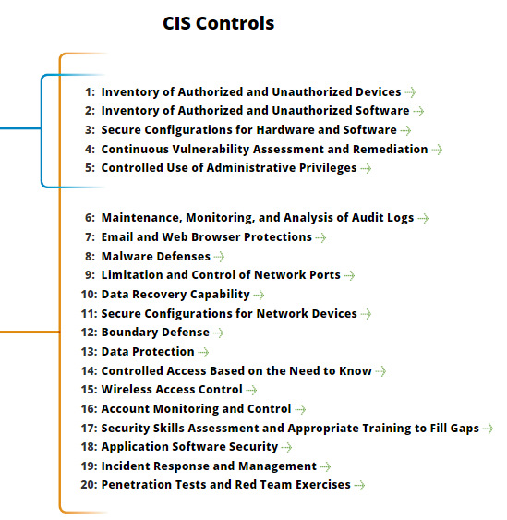
CSC5-I: Controlled Use Of Administrative Privileges
https://www.cisecurity.org/controls/

Slide 3
CSC5-I: Controlled Use Of Administrative Privileges
5.1: Minimize administrative privileges and only use administrative accounts when they are required. Implement focused auditing on the use of administrative privileged functions and monitor for anomalous behavior.

Slide 4
CSC5-I: Controlled Use Of Administrative Privileges
5.2: Use automated tools to inventory all administrative accounts and validate that each person with administrative privileges on desktops, laptops, and servers is authorized by a senior executive.

Slide 5
CSC5-I: Controlled Use Of Administrative Privileges
5.3: Before deploying any new devices in a networked environment, change all default passwords for applications, operating systems, routers, firewalls, wireless access points, and other systems to have values consistent with administration-level accounts.

Slide 6
CSC5-I: Controlled Use Of Administrative Privileges
5.4: Configure systems to issue a log entry and alert when an account is added to or removed from a domain administrators’ group, or when a new local administrator account is added on a system.

Slide 7
CSC5-I: Controlled Use Of Administrative Privileges
5.5: Configure systems to issue a log entry and alert on any unsuccessful login to an administrative account.
END

